Slide 1
Anomaly Detection of Time Series Data:
Advanced Battery Manufacturing Systems
LSTM-Autoencoder
Course: Introduction to Printed Electronics
AI-Algorithms for Manufacturing Systems
Presenter: Muhammad Abdullah Hassan Malik
Department of Advanced Battery Manufacturing Systems
Korea Institute of Machinery and Materials (KIMM)
University of Science and Technology (UST)
Algorithmic Intelligence Laboratory

Slide 2
Table of Contents
Anomaly Detection
Autoencoders – Intro and Working Principle
Long Short-Term Memory – Intro and Working Principle
LSTM-AE – How do they come together for anomaly detection?
Examples

Slide 3
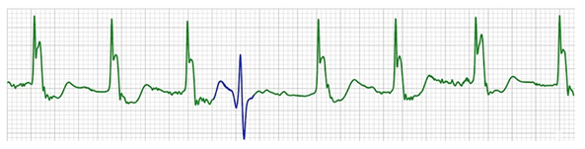

Anomaly and Anomaly Detection
An anomaly is defined as any irregularity or abnormality in the data
Anomaly
For any system anomalies in data can point to failures, inefficiencies or abrupt changes.
Examples can include:
Vibration anomalies in motor data, pointing to broken bearings
Anomalies in ECG data, pointing to heart problems
Valve actuation timing, pointing to power problems
All theses issues can result in potentially major issues, which is why anomaly detection is important!

Slide 4
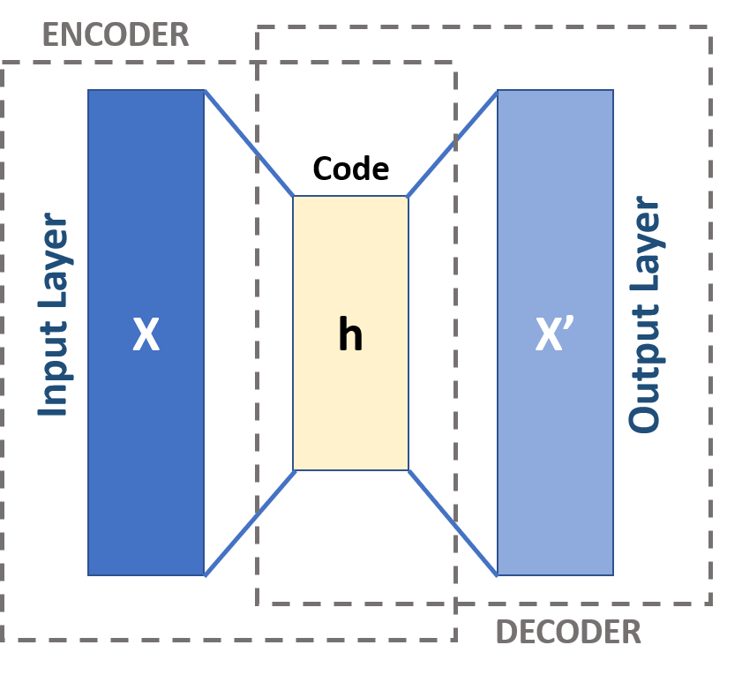
Autoencoders - Introduction
An autoencoder is a neural network trained to copy its input.
Two parts:
Encoder, that codes the input,
Decoder, that reconstructs the input from the code
Perfect autoencoder would act as an identity,
X = X’
However, this is useless!
Autoencoders are constrained to copy approximately, through different methods:
Dimension reduction
Noise introduction in input
Penalties in the loss function

Slide 5
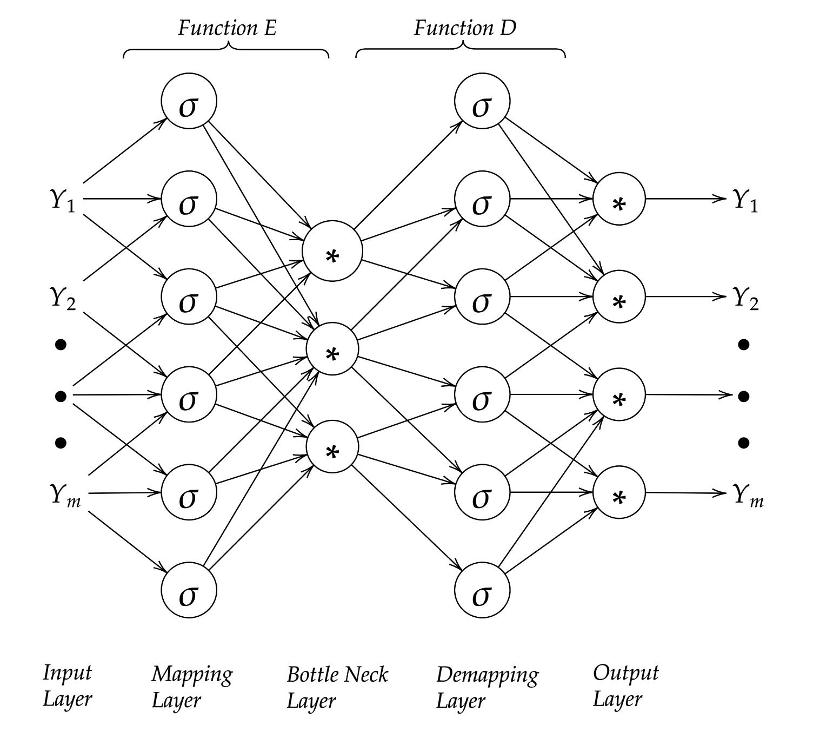
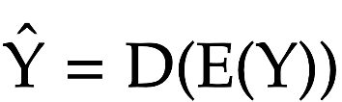
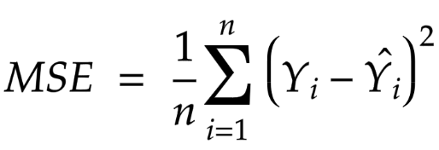
Autoencoders – Working Principle
Autoencoders can be classified as a type of feedforward network, composed of 3 layers:
Input Layer
(Multiple) Hidden Layer
Output Layer
The hidden layers contain activation functions that act to code and decode the input. Common functions are:
Sigmoid
ReLU
Linear
In summary,
Autoencoder loss is most popularly measured through mean squared error:
The autoencoder performs backpropagation to update weights.
Notes:
An autoencoder has two main parts:
1. Encoder (function G)
Takes input YYY
Compresses it into a smaller representation (called the latent vector or bottleneck)
2. Decoder (function H)
Takes the compressed representation
Reconstructs the original input Y′Y'Y′
Flow step-by-step
Input data YYY goes into the network
Encoder compresses it → latent representation TTT
Decoder expands it → reconstructed output Y′Y'Y′
The network compares YYY and Y′Y'Y′ using a cost function (often MSE)
It updates weights using Backpropagation and Gradient Descent
What the bottleneck does
The bottleneck layer forces the network to:
Remove noise
Keep only important patterns
Learn meaningful features automatically

Slide 6
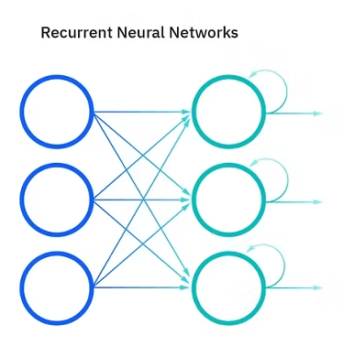
LSTM - Introduction
A LSTM (Long Short-Term Memory) is a type of recurrent neural network (RNN).
RNNs are networks that utilize data from previous neurons to capture sequential dependencies!
LSTM was created to solve the vanishing gradient problem: where when propagation occurs, the weights become very small due to consecutive multiplications. This results in the gradient vanishing, and the model slowing or halting.
Hence, the LSTM is best suited to tasks where the next data will depend on previous data. As examples:
Time series data
Natural Language Processing
Speech recognition
Healthcare
Energy forecasting

Slide 7
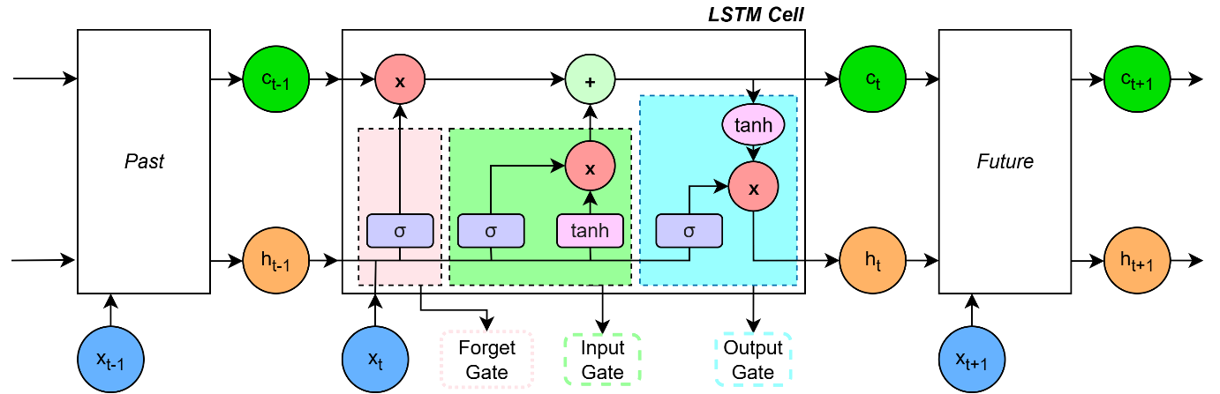
LSTM – Working Principle
A LSTM is based on a cell with 3 gates:
Forget gate
Input gate
Output gate
The forget gate takes information from the last step hidden state and new input state and adds to the cell state.
The input gate takes the same information as the forget gate and updates the cell state.
The output gate takes the current cell and input state, and the last hidden state, and creates the current hidden state.
So, simply put,
The forget gate decides how much to forget.
The input gate decides how much to learn.
The output gate decides how much to remember.
Notes:
Input Gate (IG): Controls the extent to which new information enters the cell state, protecting the memory from perturbation by irrelevant inputs.
Forget Gate (FG): An adaptive unit that enables a cell to reset its internal state when the stored information becomes out of date or useless, releasing resources for new information.
Output Gate (OG): Regulates the flow of the cell state to the rest of the network, protecting other units from being perturbed by currently irrelevant memory contents

Slide 8
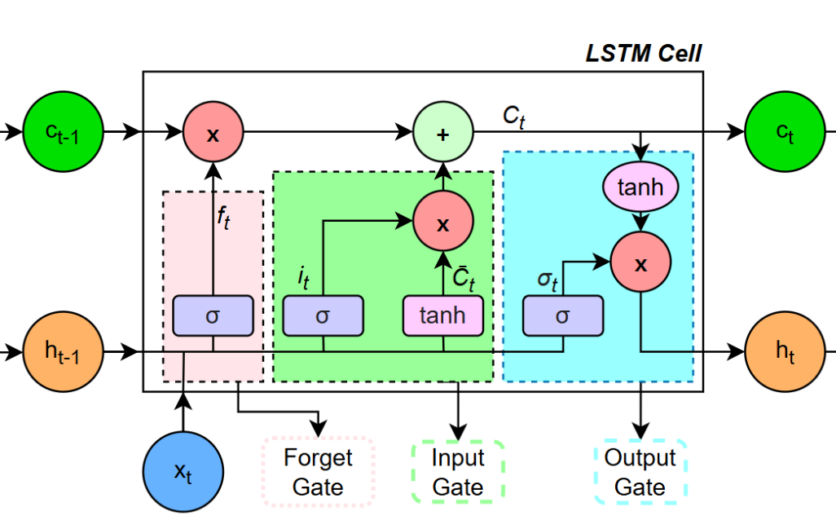
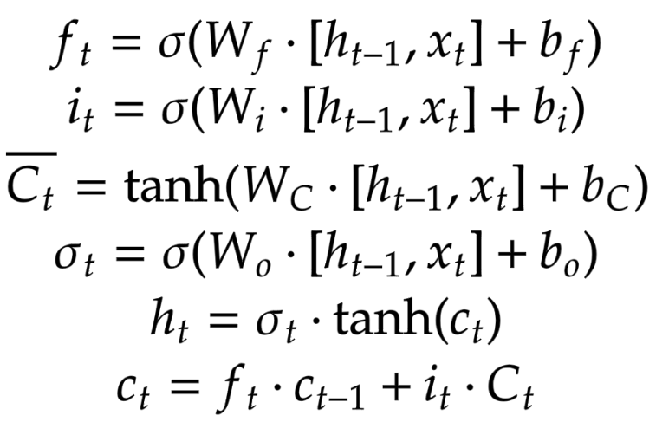
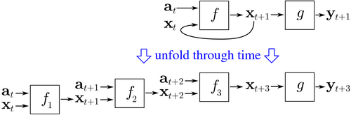
LSTM – Working Principle
Hence in mathematical terms:
LSTMs are trained through backpropagation through time, where backpropagation occurs through all timesteps.
The loss function can be varied according to the nature of the problem the LSTM is being used to solve.

Slide 9
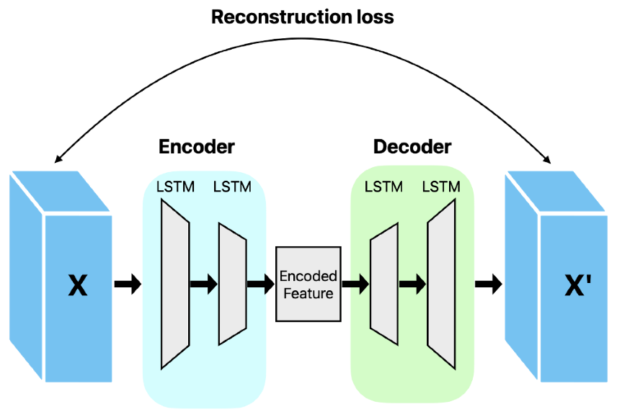
LSTM-AE – Together for Anomaly Detection
Most time series data is dependent on its history. To capture that dependency, we can use the power of LSTM combined with the detection capabilities of AE.
The model uses LSTMs as both encoder and decoder. The encoder learns the time series data, and creates a fixed vector representation.
Compressed Feature
The decoder uses the vector to reconstruct the original signal, often using its own previous prediction to guide itself.
The reconstruction error is compared, and anomalies are marked based on a predefined threshold.
Notes:
The Encoder: This component takes an input time series sequence X={x(1),x(2),…,x(L)} and maps it to a fixed-length vector representation. As the encoder processes each time step, it updates its hidden state hE(i)​. The final hidden state of the encoder, hE(L)​, encapsulates the "essence" or "code" of the entire input sequence.
The Decoder: The decoder uses the fixed-length vector from the encoder as its initial hidden state (hD(L)​=hE(L)​) to produce a reconstruction of the original sequence, X′={x′(1),x′(2),…,x′(L)}. A linear layer on top of the LSTM decoder is used to predict the actual values of the reconstructed sequence
Reverse Reconstruction: The model is often jointly trained to reconstruct the time series in reverse order. For an input {x(1),x(2),x(3)}, the target is {x(3),x(2),x(1)}.
Inference Loop: During inference, the decoder uses its own previous prediction, x′(i), as the input for the next time step to obtain the next hidden state, hD(i−1)​, and predict the next value in the sequence, x′(i−1)

Slide 10
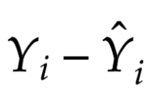
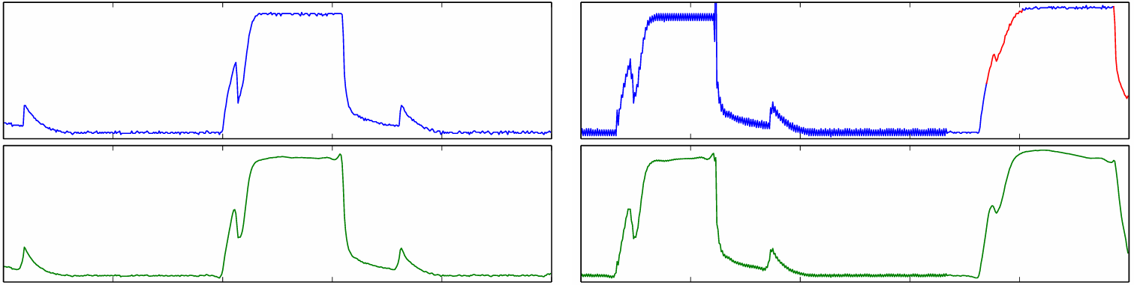
LSTM-AE – Together for Anomaly Detection
LSTM-AE needs to be trained on exclusively normal data. This allows it to learn the essence of the data.
When it reconstructs data, it will fail to reconstruct abnormal data because it only knows how to reconstruct a normal pattern.
Hence, we can use the difference between the data and the reconstructions to classify anomalies. Recall that the difference is the reconstruction error:
Training Set
Test Set
A sample from Malhotra 2016 - LSTM-based Encoder-Decoder for Multi-sensor Anomaly Detection.
Notes:
How does it really work? With an example
Training on "Normal" Data: The network is trained exclusively on non-anomalous (normal) sequences. It learns to minimize the reconstruction error, which is the difference between the input sequence and its reconstructed version (∣x(i)−x′(i)∣).
Identifying Anomalies: Because the model has only seen normal patterns, it becomes highly effective at reconstructing them. When presented with an anomalous sequence, the model fails to reconstruct it accurately because the pattern is outside its learned "normal" representation. This results in a significantly higher reconstruction error.
Anomaly Scoring: These reconstruction errors are modeled as a multivariate Gaussian distribution. For any new sequence, an anomaly score is calculated based on the likelihood of its error vector occurring under this distribution; higher scores indicate a greater probability of an anomaly

Slide 11
References
Goodfellow, I., Bengio, Y., & Courville, A. (2016). Deep Learning, Chapter 10: Sequence Modeling: Recurrent And Recursive Nets. MIT Press.
Goodfellow, I., Bengio, Y., & Courville, A. (2016). Deep Learning, Chapter 14: Autoencoders. MIT Press.
Gers, F. A., Schmidhuber, J., & Cummins, F. (1999). "Learning to Forget: Continual Prediction with LSTM." Artificial Neural Networks, 7 - 10 September 1999, Conference Publication No. 470.
Hochreiter, S., & Schmidhuber, J. (1997). "Long Short-Term Memory." Neural Computation, 9(8), 1735–1780.
Kramer, M. A. (1992). "Autoassociative Neural Networks." Computers & Chemical Engineering, Vol. 16, No. 4, pp. 313-328 (Manuscript received Jan 1991).
Malhotra, P., Vig, L., Shroff, G., & Agarwal, P. (2015). "Long Short Term Memory Networks for Anomaly Detection in Time Series." ESANN 2015 proceedings, European Symposium on Artificial Neural Networks, Computational Intelligence and Machine Learning.
Malhotra, P., Ramakrishnan, A., Anand, G., Vig, L., Agarwal, P., & Shroff, G. (2016). "LSTM-based Encoder-Decoder for Multi-sensor Anomaly Detection." ICML 2016 Anomaly Detection Workshop.
Sakurada, M., & Yairi, T. (2014). "Anomaly Detection Using Autoencoders with Nonlinear Dimensionality Reduction." MLSDA '14: Proceedings of the MLSDA 2014 2nd Workshop on Machine Learning for Sensory Data Analysis.
Zhou, C., & Paffenroth, R. C. (2017). "Anomaly Detection with Robust Deep Autoencoders." KDD '17: Proceedings of the 23rd ACM SIGKDD International Conference on Knowledge Discovery and Data Mining
Lee, Y., Park, C., Kim, N., Ahn, J., & Jeong, J. (2024). LSTM-Autoencoder Based Anomaly Detection Using Vibration Data of Wind Turbines. Sensors, 24(9), 2833.

